Slide 1
Starting with Non-Code Contributions in Kubernetes
Presenters: Divya Mohan & Savitha Raghunathan Divya_Mohan02 coffeeartgirl CNCFStudents

Slide 2

Savitha Raghunathan
Day dreamer
Senior Platform Engineer at MathWorks
Active Contributor to K8s ecosystem
1.22 Release Team Lead
SIG-Security Documentation sub-project owner
New Membership Coordinator
Mentor

Slide 3

Divya Mohan
Team Lead with HSBC
AWS Community Builder
Active contributor to FOSS projects:
Kubernetes
LitmusChaos
CNCF Ambassador
Co-organizer of CNCF Student User Group

Slide 4
Contributing to Kubernetes
Why contribute to Open Source?
Why start with Kubernetes?
Notes:
Why contribute?
Exposure, gives an opportunity to see real world collaboration, communication, mutual learning
Why start with Kubernetes?
Warm and friendly community
Brief mention about - what is a SIG
Verticals

Slide 5
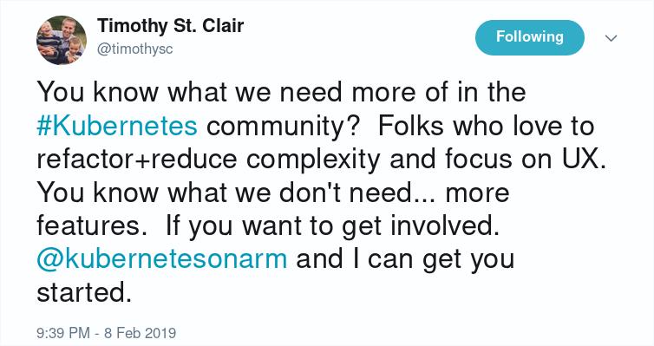
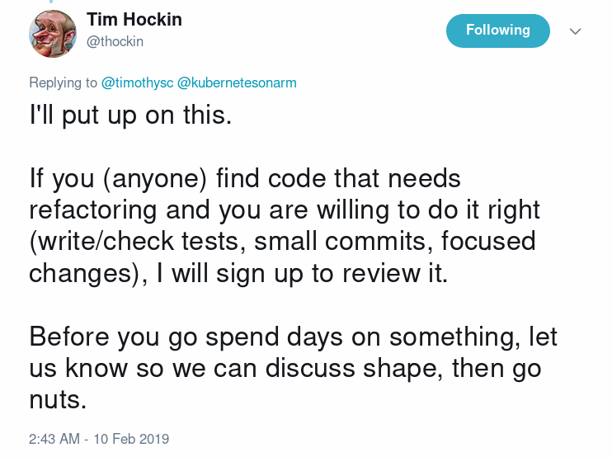
Refactor, document code, write tests and help fix test failures!
Notes:
Other slightly ad-hoc but more useful ways to jump in would be to refactor and document code, write tests and help fix test failures. I want to call this out explicitly because sometimes folks think that writing tests or fixing them is not really a “fancy” or “shiny” contribution.
However, Kubernetes is in a phase where we want to make it more stable. We don’t really want to add more features.
So honestly the project would love, ABSOLUTELY LOVE your contribution if you wrote tests or fixed them.

Slide 6
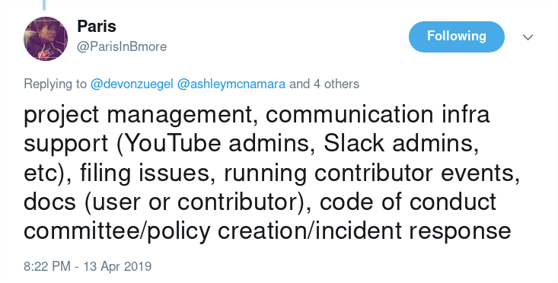
Notes:
Some examples of that include triaging issues, helping improve documentation and write blog posts.
There have been several folks who have been doing this consistently and have been promoted to lead positions in the community.
Because for good leadership, you need to care about the broader aspects of the project. Just writing code is not enough. And these type of contributions are a gateway to such lead positions.

Slide 7
Non-Code Contributions
Bug Scrub
Issue Triage
Documentation
Localization
Notes:
Issue triage
Docs
Localization
Marketing
PM
Mentoring

Slide 8
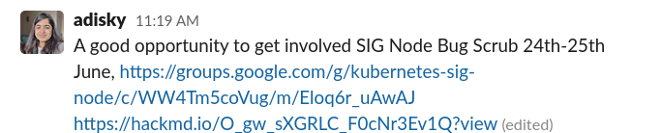
Notes:
SIG Node - the SIG that works on the kubelet and node is having a Bug Scrub session today. You can learn more about how we triage issues and if there are any issues that sound interesting to you, you can also volunteer to work on them in this session. For the APAC session, our very own Aditi Sharma will be leading it so feel free to reach out to her directly too.

Slide 9
Non-Code Contributions
Marketing
Program Management
Mentoring
Release Team shadow
KEP Reading club
Slack infra
Notes:
Issue triage
Docs
Localization
Marketing
PM
Mentoring

Slide 10
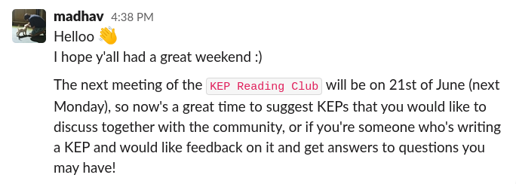
KEP Reading Club
Notes:
And for this reason exactly, one of our contributors from India, Madhav, has started a new initiative called a “KEP Reading Club” similar to a “book reading club”. It’s a GREAT way to get more context and background on why a feature was written the way it was.
Let me actually show you what a KEP looks like.

Slide 11
Best Practices
Contributor website - https://www.kubernetes.dev/
Finding good first issues

Slide 12
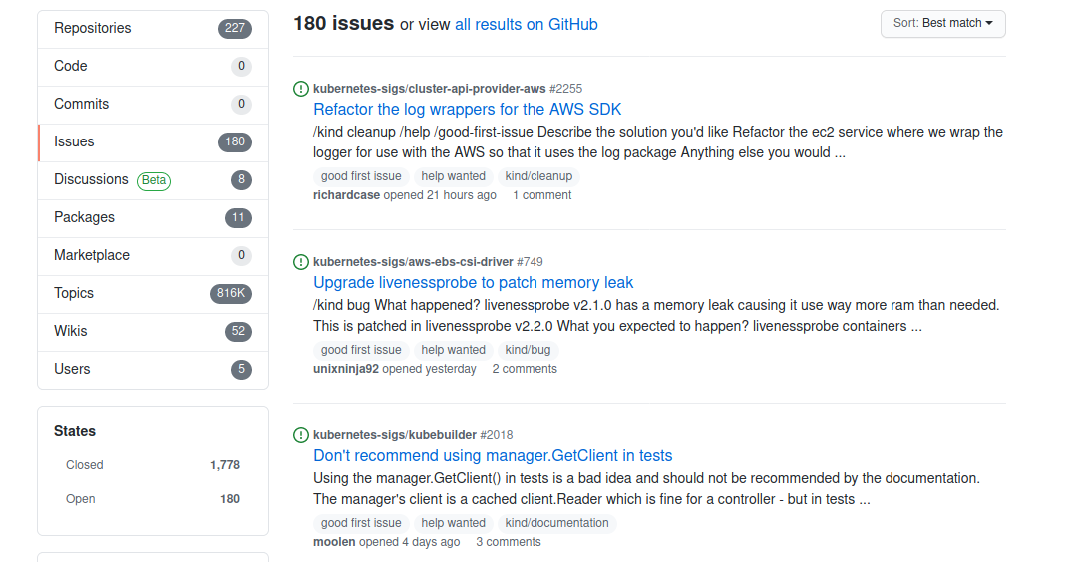
Good First Issues
https://go.k8s.io/good-first-issue
Source: Bob Killen/Sahdev Zala on #sig-contribex
Notes:
Most open source projects surface a list of issues or tasks for beginners. Kubernetes does this too using a GitHub label called “good first issue”.
If you are just starting out in the project, you can go to the link go.k8s.io/good-first-issue.
These issues have no barrier to entry - as a new contributor, you should be able to tackle these without advanced setup or domain knowledge.
The solution, background knowledge, context and links to relevant code are also explained in the issue itself.
And the best part about these issues is that you get a dedicated mentor who will work with you to get your contribution merged.
I’d really recommend starting out with this because a LOT of the existing contributors jumped in this way.

Slide 13
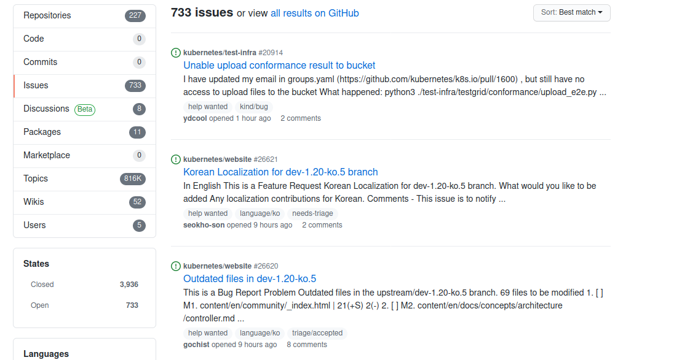
For The Initiated
https://go.k8s.io/help-wanted
Source: Bob Killen/Sahdev Zala on #sig-contribex
Notes:
When you have solved a “good first issue”, you can take a look at another set of issues with the label “Help Wanted”.
These issues also have a low barrier to entry and kind of has a Goldilocks priority... so not too high that a core contributor would do it, but not too low that it isn't useful enough for a core contributor to spend time to review it, answer questions and help get it into a release. So these are also REALLY REALLY good places to jump in.

Slide 14
….And A Lot More Ways
https://k8s.dev/docs/guide/non-code-contributions/
Notes:
Now, not all contributions have to be about code. In fact, I would actually go on to say that to keep a project like Kubernetes sustainable, you need a LARGE amount of contributions that have nothing to do with code at all.

Slide 15
Release Shadow program

Slide 16
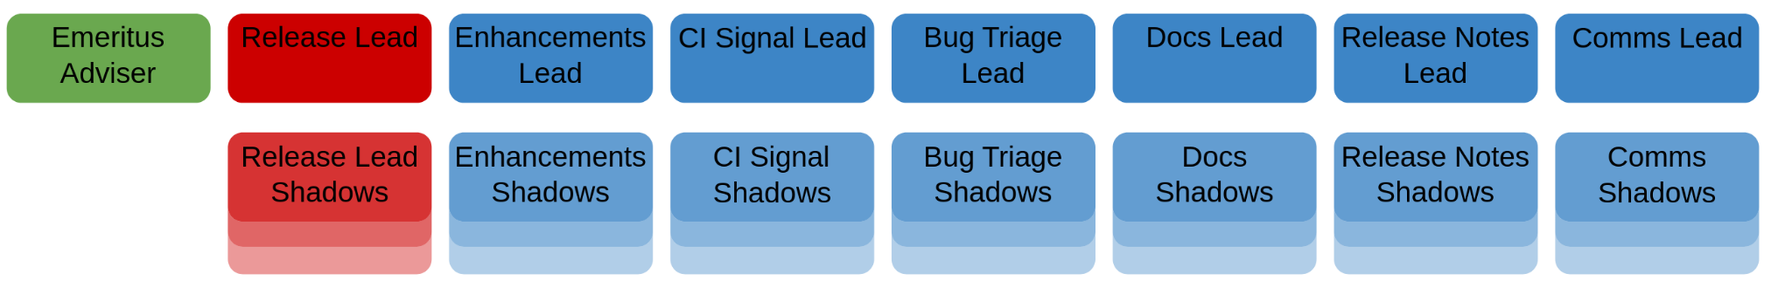
Kubernetes Release Team
Periodically releases a new version of Kubernetes
Collects features in a time frame and tracks whether the features go past the line
Ensures quality of the artifacts generated as part of the release
Image Source: https://git.k8s.io/sig-release/release-team/release-team.svg
Notes:
The Kubernetes Release Team is a subproject of the Special Interest Group Release. They are responsible for the day to day work required to successfully release while the SIG at large is focused on the continued improvement of the release process.
There are several verticals or focus areas in the release team. They handle one specific area of the release. For example, the enhancements team coordinates the features that will be released, CI Signal team continuously ensures that the quality of the release.
The Release Team follows a hierarchical team structure. An Overall Lead is designated for each Release along with a lead for each role. An emeritus advisor gets appointed from the previous release leads.
All of the lead roles select a set of 4-5 shadows ands mentors them for leading the role in a future release.

Slide 17
Release Shadow Program
Follows the apprenticeship model
Learn by doing and tagging along the lead
Helps contributors broaden their area of knowledge
https://git.k8s.io/sig-release/release-team/shadows.md
Notes:
Now that we have an idea about the release team, let’s understand what is the release team shadow program.
It is one of the mentorship initiatives run by the Kubernetes community. The shadow program teaches one the skills required to lead the release team.
The program follows an apprenticeship model. You can think of it as an internship program.
A shadow learns by doing and is expected to help the lead with the duties of the role.
The program gives an unique opportunity to help new contributors get a breadth first knowledge of the Kubernetes community.

Slide 18
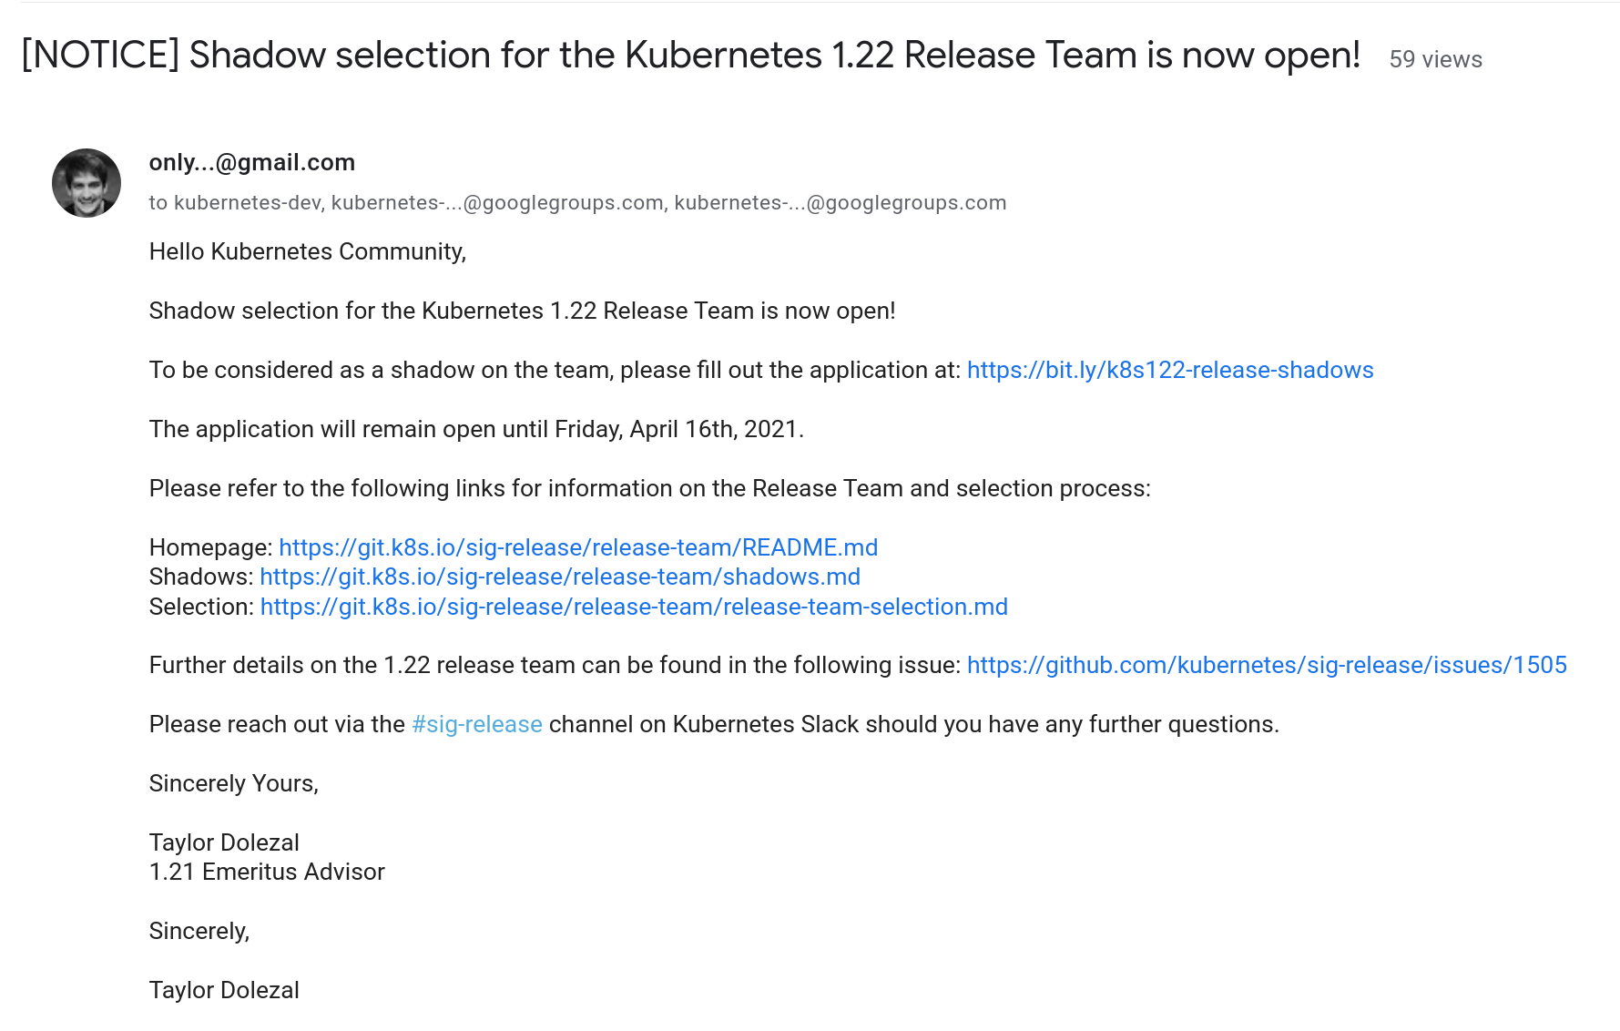
How Can I Be A Shadow
Notes:
So, how do you sign up to be a shadow?
In the last week of the previous cycle, the Emeritus Advisor + Release Team Lead will post a sign-up form on the mailing lists:
kubernetes-dev
kubernetes-release-team
kubernetes-sig-release

Slide 19
What Do I Need To Do
Read the role handbooks to understand the responsibilities of each role
Ask on #sig-release if in doubt
Fill up the form
Wait for the selection announcements
Notes:
It is very important to know what you plan to achieve from being part of the release cycle. You should read the role handbooks to understand the responsibilities of each role.
If you’re still in doubt about, ask on #sig-release channel on the Kubernetes Slack. You can also reach out to the previous / incoming role leads.
Then fill the form. Quick tip: Please provide crisp answers to the questions in the form.
And, then wait for the selections to be announced. In the past year, the Shadow Program has turned out to be very competitive. We get 100+ applications for 30ish shadow positions.
So, please don’t be disheartened if you don’t get selected. You can apply in future cycles or help out in other tasks in SIG Release. As an open source project, we always need contributors. :)
That’s all on the Release Team Shadow program.

Slide 20
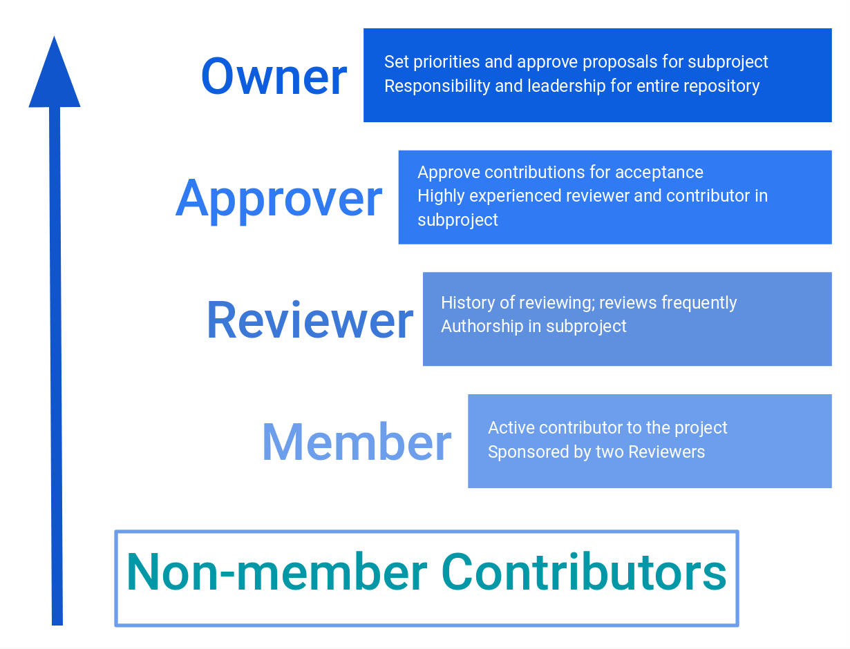
Contributor Ladder
Notes:
Once you get started with contributing, you can move contributor ladder. First, you’d become a member of the Kubernetes GitHub organization. Then you’d become a reviewer who’d be reviewing code and an approver where you can sign off on PRs and eventually an owner who sets priorities and provides leadership for subprojects.

Slide 21
Say hi!

Slide 22
Slack Channels
Step 1
Join the Slack -> slack.k8s.io
Step 2
Find #in-dev, #in-users, #in-events, #sig-contribex, #sig-docs
Step 3
Say Hi! 👋, introduce yourself and send emojis!!!

Slide 23
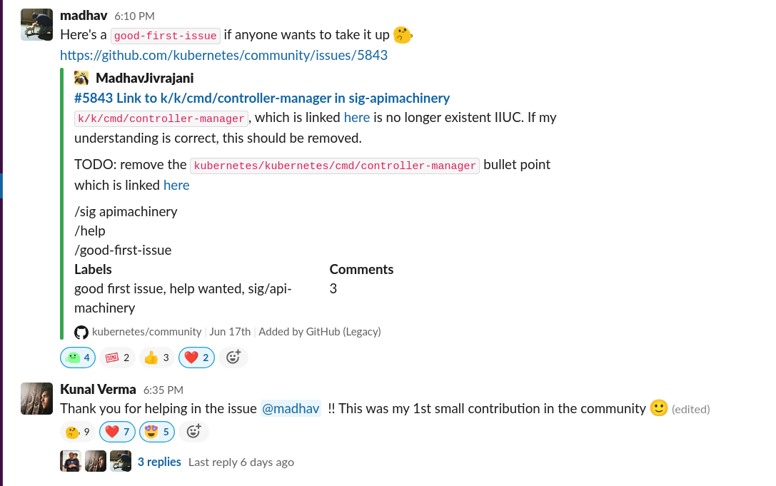

Slide 24
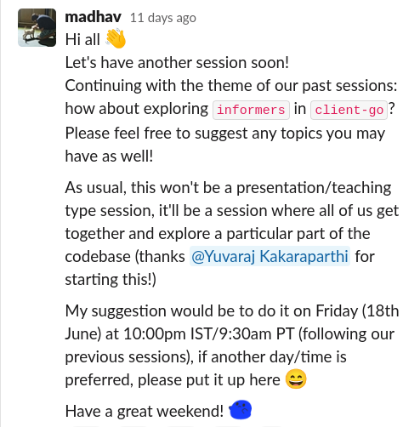
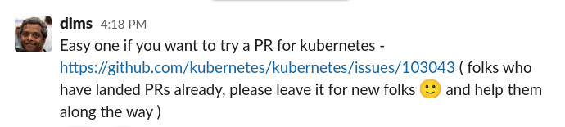

Slide 25
Resources
https://www.kubernetes.dev/
slack.k8s.io

Slide 26
Credits
Kubernetes 101 New Contributor Workshop
#sig-contribex
Individuals: Rin Oliver, Davanum Srinivas, Nikhita Raghunath, Paris Pittman, Bob Killen, Sahdev Zala

Slide 27


Slide 28
Good first issues
https://go.k8s.io/good-first-issue
Source: Bob Killen/Sahdev Zala on #sig-contribex
Notes:
Most open source projects surface a list of issues or tasks for beginners. Kubernetes does this too using a GitHub label called “good first issue”.
If you are just starting out in the project, you can go to the link go.k8s.io/good-first-issue.
These issues have no barrier to entry - as a new contributor, you should be able to tackle these without advanced setup or domain knowledge.
The solution, background knowledge, context and links to relevant code are also explained in the issue itself.
And the best part about these issues is that you get a dedicated mentor who will work with you to get your contribution merged.
I’d really recommend starting out with this because a LOT of the existing contributors jumped in this way.

Slide 29
For the initiated
https://go.k8s.io/help-wanted
Source: Bob Killen/Sahdev Zala on #sig-contribex
Notes:
When you have solved a “good first issue”, you can take a look at another set of issues with the label “Help Wanted”.
These issues also have a low barrier to entry and kind of has a Goldilocks priority... so not too high that a core contributor would do it, but not too low that it isn't useful enough for a core contributor to spend time to review it, answer questions and help get it into a release. So these are also REALLY REALLY good places to jump in.

Slide 30
…. and a lot more ways
https://k8s.dev/docs/guide/non-code-contributions/
Notes:
Now, not all contributions have to be about code. In fact, I would actually go on to say that to keep a project like Kubernetes sustainable, you need a LARGE amount of contributions that have nothing to do with code at all.

Slide 31
Kubernetes Release Team
Periodically releases a new version of Kubernetes
Collects features in a time frame and tracks whether the features go past the line
Ensures quality of the artefacts generated as part of the release
Image Source: https://git.k8s.io/sig-release/release-team/release-team.svg
Notes:
The Kubernetes Release Team is a subproject of the Special Interest Group Release. They are responsible for the day to day work required to successfully release while the SIG at large is focused on the continued improvement of the release process.
There are several verticals or focus areas in the release team. They handle one specific area of the release. For example, the enhancements team coordinates the features that will be released, CI Signal team continuously ensures that the quality of the release.
The Release Team follows a hierarchical team structure. An Overall Lead is designated for each Release along with a lead for each role. An emeritus advisor gets appointed from the previous release leads.
All of the lead roles select a set of 4-5 shadows ands mentors them for leading the role in a future release.

Slide 32
What is the Release Shadow program?
Follows the apprenticeship model
Learn by doing and tagging along the lead
Helps contributors broaden their area of knowledge
https://git.k8s.io/sig-release/release-team/shadows.md
Notes:
Now that we have an idea about the release team, let’s understand what is the release team shadow program.
It is one of the mentorship initiatives run by the Kubernetes community. The shadow program teaches one the skills required to lead the release team.
The program follows an apprenticeship model. You can think of it as an internship program.
A shadow learns by doing and is expected to help the lead with the duties of the role.
The program gives an unique opportunity to help new contributors get a breadth first knowledge of the Kubernetes community.

Slide 33
How can I be a shadow?
Notes:
So, how do you sign up to be a shadow?
In the last week of the previous cycle, the Emeritus Advisor + Release Team Lead will post a sign-up form on the mailing lists:
kubernetes-dev
kubernetes-release-team
kubernetes-sig-release

Slide 34
What do I need to do?
Read the role handbooks to understand the responsibilities of each role
Ask on #sig-release if in doubt
Fill up the form
Wait for the selection announcements
Notes:
It is very important to know what you plan to achieve from being part of the release cycle. You should read the role handbooks to understand the responsibilities of each role.
If you’re still in doubt about, ask on #sig-release channel on the Kubernetes Slack. You can also reach out to the previous / incoming role leads.
Then fill the form. Quick tip: Please provide crisp answers to the questions in the form.
And, then wait for the selections to be announced. In the past year, the Shadow Program has turned out to be very competitive. We get 100+ applications for 30ish shadow positions.
So, please don’t be disheartened if you don’t get selected. You can apply in future cycles or help out in other tasks in SIG Release. As an open source project, we always need contributors. :)
That’s all on the Release Team Shadow program.

Slide 35
Getting involved
Notes:
Once you get started with contributing, you can move contributor ladder. First, you’d become a member of the Kubernetes GitHub organization. Then you’d become a reviewer who’d be reviewing code and an approver where you can sign off on PRs and eventually an owner who sets priorities and provides leadership for subprojects.

Slide 36

India specific Slack channels
Step 1
Join the Slack -> slack.k8s.io
Step 2
Find #in-dev, #in-users, #in-events
Step 3
Say Hi! 👋, introduce yourself and send emojis!!!

